Slide 1
Lecture 6: Industry and Competitive Analysis
Barringer Chapter 5
Notes:
https://www.youtube.com/watch?v=opNiKBP7hQo https://www.youtube.com/watch?v=1gg2vXq-1VI 2"00 Paul Graham https://www.youtube.com/watch?v=2lcp0uZsY7k

Slide 2
Industry Analysis

Slide 3
Ba 260 Lecture 6
Importance
What is Industry Analysis
Industry
An industry is a group of firms producing a similar product or service, such as airlines, fitness drinks, furniture, or electronic games.
Industry Analysis is business research that focuses on the potential of an industry.
Once it is determined that a new
venture is feasible in regard to the
industry and market in which it
will compete, a more in-depth
analysis is needed to learn the ins
and outs of the industry.
The analysis helps a firm determine
if the target market it identified
during feasibility analysis is
favorable for a new firm.

Slide 4
Ba 260 Lecture 6
Three Key Questions
When studying an industry, an entrepreneur must answer three questions before pursuing the idea of starting a firm.
Is the industry
accessible—in other
words, is it is realistic
place for a new
venture to enter?
Question 1
Does the industry
contain markets that
are ripe for innovation
or are underserved?
Question 2
Are there positions in
the industry that avoid
some of the negative
attributes of the
industry as a whole?
Question 3
Notes:
Accessible
Ready for innovation or underserved
Avoid negative aspects as a whole

Slide 5


Ba 260 Lecture 6
How Industry and Firm-Level Factors Affect Performance
Firm-Level Factors
Include a firm’s assets, products, culture, teamwork among its employees, reputation, and other resources.
Industry-Level Factors
Include threat of new entrants, rivalry among existing firms, bargaining power of buyers, and related factors.
Conclusion
In various studies, researchers have found that from 8% to 30% of the variation in firm profitability is directly attributable to the industry in which a firm competes.
Firm factors can play a major role on the success of a firm,

Slide 6
Ba 260 Lecture 6
Assessing Industry Attractiveness
Study Environmental
and Business Trends
The Five Competitive
Forces Model

Slide 7
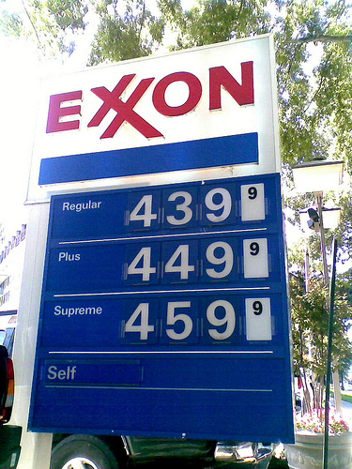
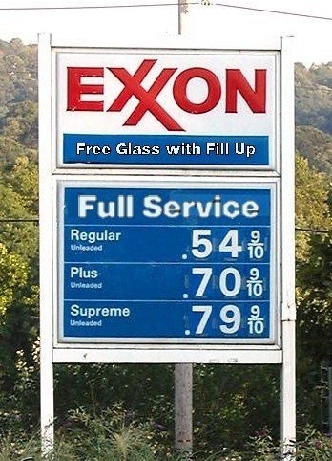
Ba 260 Lecture 6
Studying Industry Trends
Environmental Trends
Include economic trends, social trends, technological advances, and political and regulatory changes.
For example, industries that sell products to seniors are benefited by the aging of the population.
Business Trends
Other trends that impact an industry.
For example, are profit margins in the industry increasing or falling?
Is innovation accelerating or waning?
Are input costs going up or down?
A trend over the last 30 years is the increase in gas prices
Negative: Logistics
Positive: Tesla

Slide 8
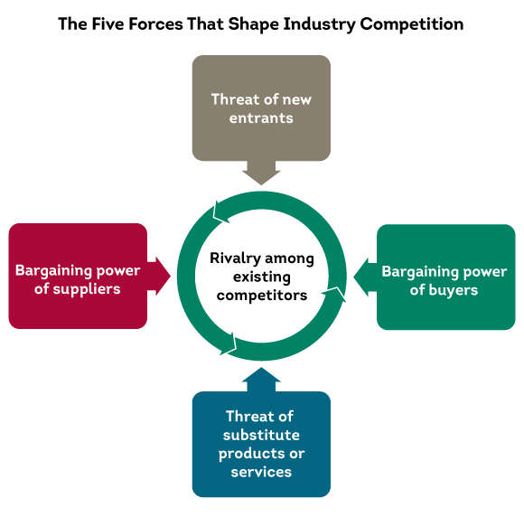
Ba 260 Lecture 6
Porters Five Forces Model
Explanation of the Five Forces Model
The five competitive forces model is a framework for understanding the structure of an industry.
The model is composed of the forces that determine industry profitability.
They help determine the average rate of return for the firms in an industry.
Each of the five forces impacts the average rate of return for the firms in an industry by applying pressure on industry profitability.
Well managed firms try to position their firms in a way that avoids or diminishes these forces—in an attempt to beat the average rate of return of the industry.

Slide 9
Ba 260 Lecture 6
Threat of Substitutes
The price that consumers are willing to pay for a product depends in part on the availability of substitute products.
For example, there are few if any substitutes for prescription medicines, which is one of the reasons the pharmaceutical industry is so profitable.
In contrast, when close substitutes for a product exist, industry profitability is suppressed, because consumers will opt out if the price gets too high.

Slide 10
Ba 260 Lecture 6
Threat of Substitutes
The extent to which substitutes suppress the profitability of an industry depends on the propensity for buyers to substitute between alternatives.
This is why firms in an industry often offer their customers amenities to reduce the likelihood that they will switch to a substitute product, even in light of a price increase.

Slide 11
Ba 260 Lecture 6
Threat of New Entrants
If the firms in an industry are highly profitable, the industry becomes a magnet to new entrants.
Unless something is done to stop this, the competition in the industry will increase, and average industry profitability will decline.
Firms in an industry try to keep the number of new entrants low by erecting barriers to entry.
A barrier to entry is a condition that creates a disincentive for a new firm to enter an industry.

Slide 12
Ba 260 Lecture 6
Threat of New Entrants
Barriers to Entry:
Barrier to Entry
Explanation
Industries that are characterized by large economies of scale are difficult for new firms to enter, unless they are willing to accept a cost disadvantage.
Economies of Scale
Industries such as the soft drink industry that are characterized by firms with strong brands are difficult to break into without spending heavily on advertising.
Product differentiation
Capital requirements
The need to invest large amounts of money to gain entrance to an industry is another barrier to entry.

Slide 13
Ba 260 Lecture 6
Threat of New Entrants
Barriers to Entry (cont)
Barrier to Entry
Explanation
Existing firms may have cost advantages not related to size. For example, the existing firms in an industry may have purchased land when it was less expensive than it is today.
Cost advantages independent of size
Distribution channels are often hard to crack. This is particularly true in crowded markets, such as the convenience store market.
Access to distribution channels
Government and legal barriers
Some industries, such as broadcasting, require the granting of a license by a public authority to compete.

Slide 14
Ba 260 Lecture 6
Threat of New Entrants
Barriers to Entry
Nontraditional Barriers to Entry
It is difficult for start-ups to execute barriers to entry that are expensive, such as economies of scale, because money is usually tight.
Start-ups have to rely on nontraditional barriers to entry to discourage new entrants, such as assembling a world-class management team that would be difficult for another company to replicate.

Slide 15
Ba 260 Lecture 6
Threat of New Entrants
Nontraditional Barriers to Entry
Barrier to Entry
Explanation
If a start-up puts together a world-class management team, it may give potential rivals pause in taking on the start-up in its chosen industry.
Strength of management team
If a start-up pioneers an industry or a new concept within an industry, the name recognition the start-up establishes may create a barrier to entry.
First-mover advantage
If the employees of a start-up are motivated by the unique culture of a start-up, and anticipate a large financial reward, this is a combination that cannot be replicated by larger firms.
Passion of the management team and employees

Slide 16
Ba 260 Lecture 6
Threat of New Entrants
Nontraditional Barriers to Entry (cont)
Barrier to Entry
Explanation
If a start-up is able to construct a unique business model and establish a network of relationships that makes the business model work, this set of advantages creates a barrier to entry.
Unique business model
Some Internet domain names are so “spot-on” that they give a start-up a meaningful leg up in terms of e-commerce opportunities.
Internet domain name
Inventing a new approach to an industry
If a start-up invents a new approach to an industry and executes it in an exemplary fashion, these factors create a barrier to entry for potential imitators.

Slide 17
Ba 260 Lecture 6
Rivalry Among Existing Firms
In most industries, the major determinant of industry profitability is the level of competition among existing firms.
Some industries are fiercely competitive, to the point where prices are pushed below the level of costs, and industry-wide losses occur.
In other industries, competition is much less intense and price competition is subdued.

Slide 18
Ba 260 Lecture 6
Rivalry Among Existing Firms
Number and balance of competitors
The more competitors there are, the more likely it is that one or more will try to gain customers by cutting its price.
Degree of difference between products
The degree to which products differ from one product to another affects industry rivalry.

Slide 19
Ba 260 Lecture 6
Rivalry Among Existing Firms
The competition among firms in a slow-growth industry is stronger than among those in fast-growth industries.
Growth rate of an industry
Firms that have high fixed costs must sell a higher volume of their product to reach the break-even point than firms with low fixed costs.
Level of fixed costs

Slide 20
Ba 260 Lecture 6
Bargaining Power of Suppliers
Suppliers can suppress the profitability of the industries to which they sell by raising prices or reducing the quality of the components they provide.
If a supplier reduces the quality of the components it supplies, the quality of the finished product will suffer, and the manufacturer will eventually have to lower its price.
If the suppliers are powerful relative to the firms in the industry to which they sell, industry profitability can suffer

Slide 21
Ba 260 Lecture 6
Bargaining Power of Suppliers
Factors that have an impact on the ability of suppliers to exert pressure on buyers
Supplier concentration
When there are only a few suppliers that supply a critical product to a large number of buyers, the supplier has an advantage.
Switching costs are the fixed costs that buyers encounter when switching or changing from one supplier to another. If switching costs are high, a buyer will be less likely to switch suppliers.
Switching costs

Slide 22
Ba 260 Lecture 6
Bargaining Power of Suppliers
Factors that have an impact on the ability of suppliers to exert pressure on buyers
Attractiveness of substitutes
Supplier power is enhanced if there are no attractive substitutes for the product or services the supplier offers.
Threat of forward integration
The power of a supplier is enhanced if there is a credible possibility that the supplier might enter the buyer’s industry.

Slide 23
Ba 260 Lecture 6
Bargaining Power of Buyers
Buyers can suppress the profitability of the industries from which they purchase by demanding price concessions or increases in quality.
For example, the automobile industry is dominated by a handful of large companies that buy products from thousands of suppliers in different industries. This allows the automakers to suppress the profitability of the industries from which they buy by demanding price reductions.

Slide 24
Ba 260 Lecture 6
Bargaining Power of Buyers
Factors that have an impact on the ability of suppliers to exert pressure on buyers
If there are only a few large buyers, and they buy from a large number of suppliers, they can pressure the suppliers to lower costs and thus affect the profitability of the industries from which they buy.
Buyer group concentration
The greater the importance of an item is to a buyer, the more sensitive the buyer will be to the price it pays.
Buyer’s costs

Slide 25
Ba 260 Lecture 6
Bargaining Power of Buyers
Factors that have an impact on the ability of suppliers to exert pressure on buyers
Degree of standardization of supplier’s products
The degree to which a supplier’s product differs from its competitors affects the buyer’s bargaining power.
Threat of backward integration
The power of buyers is enhanced if there is a credible threat that the buyer might enter the supplier’s industry.

Slide 26
Ba 260 Lecture 6
First Application of the Model
The five forces model can be used to assess the attractiveness of an industry by determining the level of threat to industry profitability for each of the forces.
If a firm fills out the form shown on the next slide and several of the threats to industry profitability are high, the firm may want to reconsider entering the industry or think carefully about the position it would occupy.

Slide 27
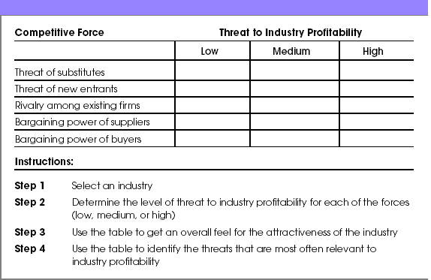
Ba 260 Lecture 6
Assessing Industry Attractiveness Using the Five Forces Model

Slide 28
Ba 260 Lecture 6
Second Application of the Model
The second way a new firm can apply the five forces model to help determine whether it should enter an industry is by using the model to answer several key questions.
The questions are shown in the figure on the next slide, and help a firm project the potential success of a new venture in a particular industry.

Slide 29
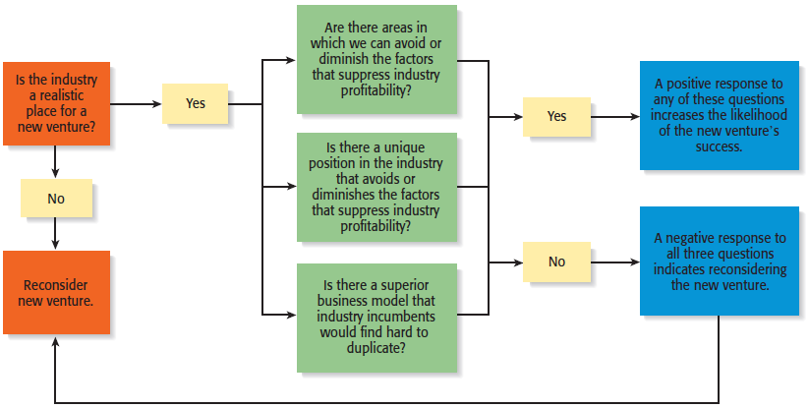
Ba 260 Lecture 6

Slide 30
Ba 260 Lecture 6
Industry Types and the Opportunities They Offer
Emerging Industries
Industries in which standard operating procedures have yet to be developed.
Opportunity: First-mover advantage
Fragmented Industries
Industries that are characterized by a large number of firms of approximately equal size.
Opportunity: Consolidation

Slide 31
Ba 260 Lecture 6
Industry Types and the Opportunities They Offer
Mature Industries
Industries that are experiencing slow or no increase in demand.
Opportunities: Process innovation and after-sale service innovation
Declining Industries
Industries that are experiencing a reduction in demand.
Opportunities: Leadership, establishing a niche market, and pursuing a cost reduction strategy
Global Industries
Industries that are experiencing significant international sales.
Opportunities: Multidomestic and global strategies

Slide 32
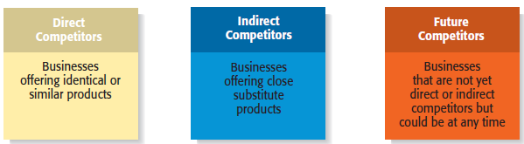
Ba 260 Lecture 6
Competitor Analysis
What is a Competitor Analysis?
A competitor analysis is a detailed analysis of a firm’s competition.
It helps a firm understand the positions of its major competitors and the opportunities that are available.
A competitive analysis grid is a tool for organizing the information a firm collects about its competitors.

Slide 33
Ba 260 Lecture 6
Competitor Analysis
Collecting Competitive Intelligence
To complete a competitive analysis grid, a firm must first understand the strategies and behaviors of its competitors.
The information that is gathered by a firm to learn about its competitors is referred to as competitive intelligence.
A new venture should take care that it collects competitive intelligence in a professional and ethical manner.

Slide 34
Ba 260 Lecture 6
Competitor Analysis
Ethical ways to obtain information about competitors
Attend conferences and trade shows.
Purchase competitors’ products.
Study competitors’ Web sites.
Set up Google and Yahoo! e-mail alerts.
Read industry-related books, magazines, and Web sites.
Talk to customers about what motivated them to buy your product as opposed to your competitor’s product.

Slide 35
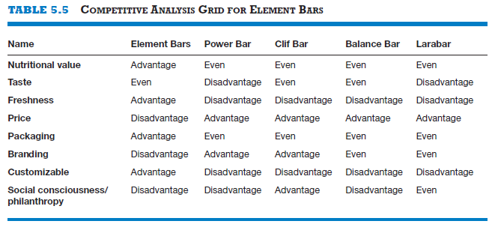
Ba 260 Lecture 6
Competitor Analysis
Competitive Analysis Grid
A tool for organizing the information a firm collects about its competitors
A competitive analysis grid can help a firm see how it stacks up against its competitors, provide ideas for markets to pursue, and identify its primary sources of competitive advantage.

Slide 36
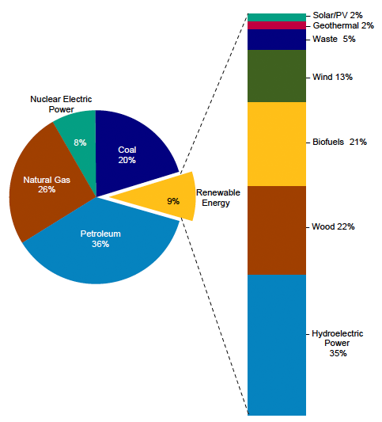
Ba 260 Lecture 6
The Nuclear Power Industry
Porter’s Five Forces
PESTLE Analysis

Slide 37
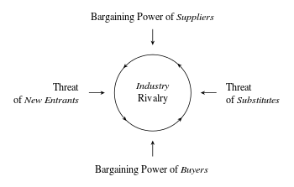
Ba 260 Lecture 6
The Nuclear Power Industry
Porter’s Five Forces
PESTLE Analysis
Political
Economic
Social
Technological
Legal
Environmental

Slide 38
Market Analysis

Slide 39
Ba 260 Lecture 6
Industry and Market
Markets
Consist of Customers (Buyers)
People or Businesses Willingness to Buy Ability to Buy
Unsatisfied or Unmet Needs
Industry
Consists of Sellers
Companies producing goods or services
Located somewhere in the Value Chain
In search of customers

Slide 40
Ba 260 Lecture 6
Market Assessment
Structured approach to defining demand potential
Identify customers
Who
How Many
Where are They
How to Reach them
What motivates them to buy?
How Big is the Market
Is the Market Growing, Stagnant or Shrinking

Slide 41
Ba 260 Lecture 6
Market Assessment
Why Do It?
Understand the Opportunity
Spot Potential Sales
Reduce Business Risk
Plan Your Marketing Approach
Make Informed Decisions
Spot Potential Problems

Slide 42
Ba 260 Lecture 6
Market Assessment
What are you Trying to Learn
How big the Market it
How Fast it is Growing
Who and where the idea customers are

Slide 43
Ba 260 Lecture 6
Market Assessment
The Language of Markets
Industry
Segment
Target Market
Niche Market
Target Customer
Positioning

Slide 44
Ba 260 Lecture 6
Market Segment
The division of broad markets into smaller groups sharing similar needs and attributes
Most broad markets have several distinct segments
Gourmet Chefs vs Cooks
Vegans vs Vegetarians

Slide 45
Ba 260 Lecture 6
Customer Segments
Demographics
Age
Gender
Economic
Income
Spending Habits
Geographic
Location
Where they Buy
Psychographic/Behavioral
Why they Buy
Lifestyle

Slide 46
Ba 260 Lecture 6
Your Target Market
The Segment(s) on which Your Business can Focus
The Segment(s) in which Your Business has an advantage
Your Niche Market

Slide 47
Ba 260 Lecture 6
Target Customer
Those customers who when presented with perfect information about your product or service, along with your competitors will buy yours

Slide 48
Ba 260 Lecture 6
Positioning
How your target customers’ perceive your product vis a vis competing alternatives
Consciously molded by your market strategy
Independently internalized by your customers

Slide 49
Ba 260 Lecture 6
Market Assessment
Why Do It?

Slide 50
Ba 260 Lecture 6
Market Assessment
Why Do It?

